Slide 1

Customer Default Credit Card
Reza Kusnadi

Slide 2
Table of Contents
01
02
03
Data Preparations & Understanding
Data Cleaning
Exploratory Data Analysis
04
05
Modelling
Conclusion

Slide 3

Objective
The reason for this objective is to predict probability of default obligation especially credit cards.
Will allowed and generate strategies and minimize risk from default, and can be provide different treatment.

Slide 4

01
Data Preparations & Understanding

Slide 5

About the Data
This dataset contains information on default payments, demographic factors, credit data, history of payment, and bill statements of credit card clients.

Slide 6
Data Understanding
30.000 rows
25 Features
1 Target
Contain 30.000 Customers
Limit Average Credit Card 167.484
Most client education Grad School & Univ
Marital status 75% Single & 25% Married
Average Age 35 years old
No Missing Value
Possible drop Column ID
Target Column default.payment.next.month
Target Columns mean 0.22 , means 22% default

Slide 7

Data Cleansing
02

Slide 8

Data Cleaning
Droping Column ID
Renaming columns target from default.payment.next.month -> defauly_pay
Renaming columns Pay_0 -> Pay_1 for better sequence columns
Simplified column marriage and educations from unknown to column others, because had similar value

Slide 9

Exploratory Data Analysis
03

Slide 10
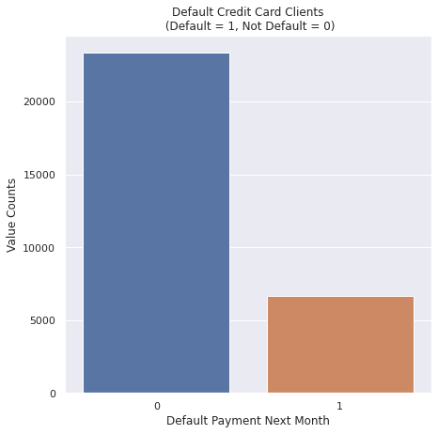
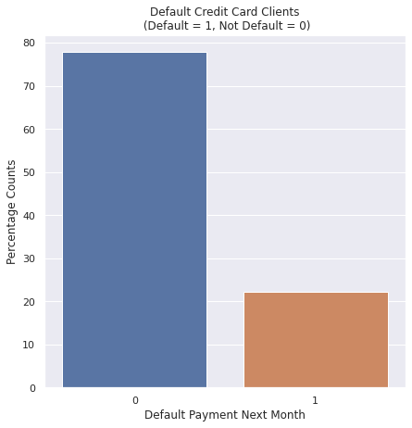
Target Feature Analysis
Imbalance Data With Ratio 72:22

Slide 11
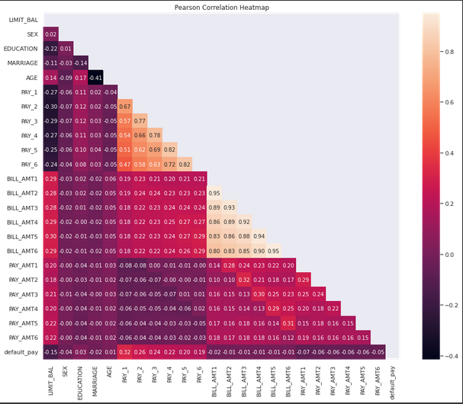
Correlation Analysis

Slide 12
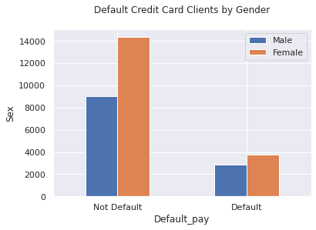
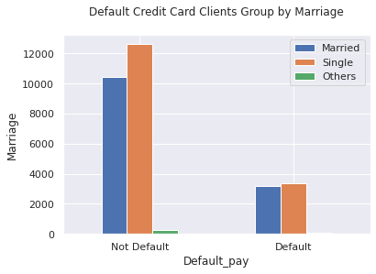
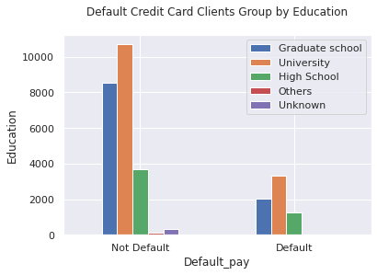
Target Feature Analysis vs Categorial Feature
Insight :
Female user more likely Default
Married user more likely Default
Grad School more likely Default followed by University

Slide 13
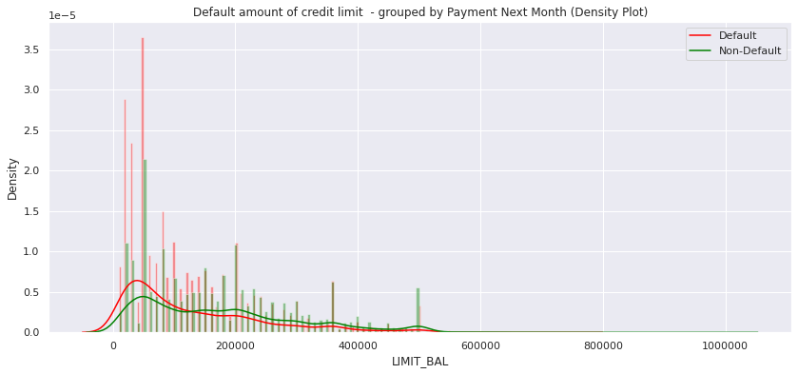
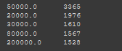
Target Feature Analysis vs Limit Balance
Insight :
Most likely user default on limit balance 0 - 100000
With most user of 3365 on 50.000 limit balance

Slide 14
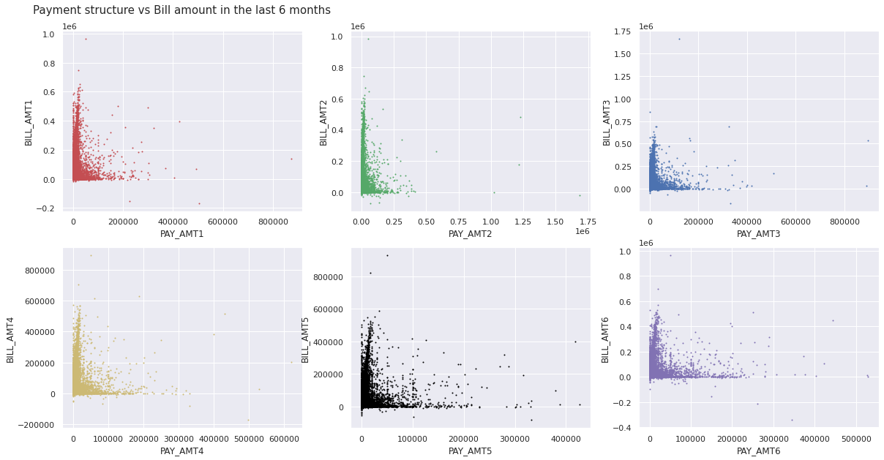
Target Feature Analysis vs Limit Balance
Higher clients with amount of bill payout the bills ,

Slide 15

Modelling
04

Slide 16

Modelling
Machine Learning Comparasion
Model | Accuracy | Recall | Precision | AUC | f1_Score
Random Forest | 0.8449 | 0.8108 | 0.8713 | 0.8451 | 0.8400
LightGBM | 0.8638 | 0.7972 | 0.9208 | 0.8640 | 0.8545
Decision Tree | 0.7663 | 0.7368 | 0.7844 | 0.7664 | 0.7598
Logistic Regression | 0.6671 | 0.6452 | 0.6766 | 0.6672 | 0.6605
Premium
Accuracy is percentage of prediction were correct.
AUC (Area Under the Curve) means model has a good measure of separability if it has AUC near to 1
Recall is actual positive rate.
Precision is predicted positive rate
F1-Score combines Recall and Precision to one performance matrix.

Slide 17
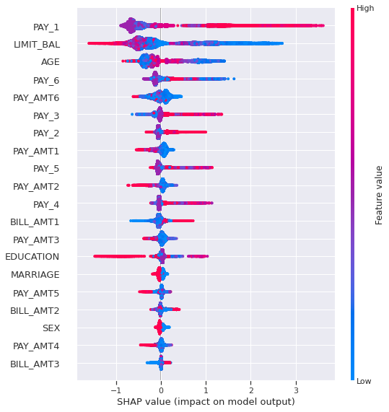
Shap Feature Importance by best Model
Selected Model LightGBM
Feature Sort by Desc order of feature importance
From the plot PAY_1 is the most importance feature for going to drive prediction

Slide 18

Conclusion
05

Slide 19

Conclusion
Modeling
Insight Business
The Best model that can be used for this Dataset Calssification is LightGBM
From EDA Above we can allowed and generate strategies and minimize risk from default, and can be provide different treatment such :
Offer for segmented customer to used Pay Protection from the start of their bill
Payment Structuring for default segmented customer
Moreover can also generate a marketing strategies for customer whom had a good payment such :
Offer more limit balanced (Level Up Card Type)
Offer New Credit Card for their family member.
Or make a new promo for segmented customer to increase the transactions

Slide 20

Thank You
Reza kusnadi

Slide 21
Harus tau kenapa lu pake modliing itu , buat apa bagaimana cara pakainya!!!!
Metrics yang lu pakai apa maunya dalam machine learning , accuracy precision atau apa nya
Precision harusnya karena hanya melihat 1 atau 0 ny saja
Tapi kalau accuracy 1 dan 0 ny di lihat , karena memang mau di kasih recommendation untuk recommendation Default dan non-default
Kalau mau menurunkan churn , bukan isi model ny yang di gunakan , berapa penting variable yang di gunakan apa saja
EDA , strategis dalam preprocessing , bukan untuk business insight
Machine learning metriks , tentuin berdasarkan dari resiko dari model machine learning ny
Recommendation , terkuantifikasi impact ny apa, harus terhitung hasilny apa kalau sudah di jalankan .

